Slide 1

TutorME
Native Coders

Slide 2
About us
We are a group of forward-thinking students aiming to assist our peers in achieving success in their academic pursuits.

Slide 3
Problem
Market gap
Customers
Costs
There is no unified mobile platform for university students to discover and connect with student tutors.
Primarily focus on private university students.
Lack of knowledge about higher education, coupled with the high academic pressure can lead to students discontinuing their studies.
BENEFITS
usability
Design
Support students in persisting and excelling in their studies.
Both student and tutors want an application that combines user-friendliness with robust functionality.
Current platforms are not to intuitive to use. Only offer limited functionality.

Slide 4
Solution
Close the gap
Our app make it easy for students and tutors to find and connect with each other.
Target audience
University students
Time & Cost savings
Time-saving for students and cost-cutting for tutors.
Easy to use
An intuitively user-friendly interface accessible to non-technical students.

Slide 5

App Features
Streamlined class management
Evaluate tutor performance
Simplified payment procedures
Marketplace for study materials

Slide 6
Market overview
huge growth potential
Low Risk
NO DIRECT COMPETITON
A growing number of individuals opt to pursue higher education.
A proven business strategy
Currently there are no direct competitors.

Slide 7
Market Oppotunity
15
Private Universities
30k
Students per university
25%
Estimated market size

Slide 8
Our competition
TutorME
Competitors
Exclusive platform for university education
Simple and easy to use, compared to the complex tools of the competitors
Ablility to engage with tutors and secure in-app payment process is the main draw for students to adopt our products
- MyTutor Service is limited to secondary education.
- Siplo Currently their services appear to be inactive.
- OnlineTuition.lk Service is limited to finding users.

Slide 9
Our competition
Convenient
TutorME
MyTutor
Limited Functionality
Advanced Functionality
Siplo
OnlineTuition.lk
Inconvenient

Slide 10

Revenue model
Commission from each tutoring session conducted by tutors.
Provide badges according to user ratings and performance, which users can display after a purchase. (To be implemented.)

Slide 11
Deployment Strategy
December 2024
Expand to other private universities
August 2024
Expand to other SLIIT branch universities
January 2024
Gather feedback from students and continue to improve application
December 2023
Field Testing within SLIIT campus, Malabe

Slide 12
Marketing and Sales Strategy
Social Media
Word Of Mouth
Offer 1-month free trial for tutors

Slide 13


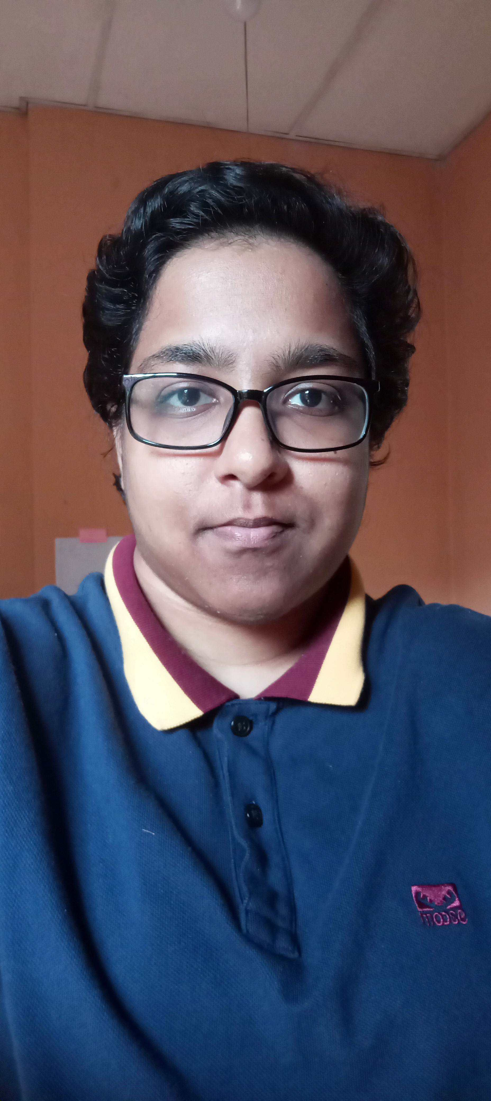
Meet the team
SADS Kumarathunga
SMRR Siriwardhana
IA Kumanayake
WGM Rashen
President
Chief Executive Officer
Chief Operations Officer
Chief Marketing Officer

Slide 14
WE are looking for
100k invesement
For 25% share of the company

Slide 15

Summary
At TutorME, we believe in giving 110%. By providing platform that connects students and tutors, we help students to succeed in their studies. We thrive because of our market knowledge and an unwavering commitment to fostering innovation.

Slide 16


Thank you

